Slide 1
Rational Exponents and Radical Functions
Algebra 2
Chapter 6
Notes:
Algebra II 6

Slide 2
This Slideshow was developed to accompany the textbook
  Larson Algebra 2
  By Larson, R., Boswell, L., Kanold, T. D., & Stiff, L.
  2011 Holt McDougal
Some examples and diagrams are taken from the textbook.
Slides created by
Richard Wright, Andrews Academy
rwright@andrews.edu

Slide 3

6.1 Evaluate n^{th} Roots and Use Rational Exponents
Root
  If a² = b, then a is a square (2nd) root of b
  If a^{n} = b, then a is the n^{th} root of b
Parts of a radical
$$\sqrt[3]{64}$$
Radical Sign
Index
Radicand

Slide 4

6.1 Evaluate n^{th} Roots and Use Rational Exponents
Rational Exponents
  $b^{1/n}=\sqrt[n]{b}$
  $b^{m/n}=\sqrt[n]{b^{m}}={\left(\sqrt[n]{b}\right)}^{m}$
Evaluate
  ${36}^{1/2}$
Notes:
√36 = 6

Slide 5
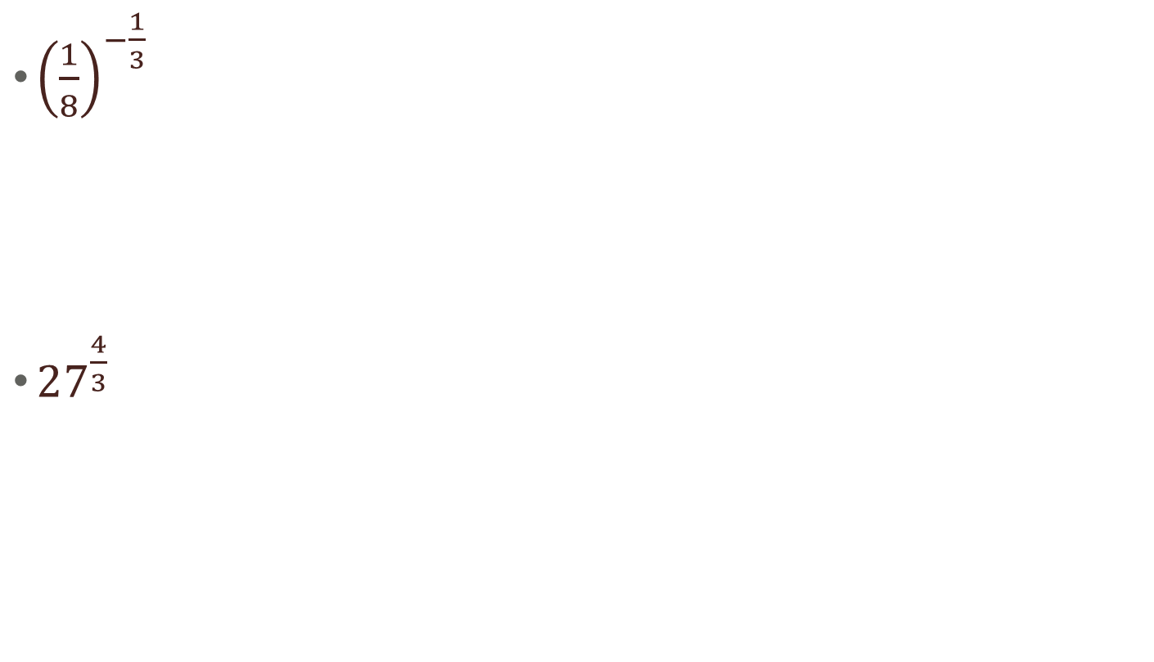
6.1 Evaluate n^{th} Roots and Use Rational Exponents
${\left(\frac{1}{8}\right)}^{−\frac{1}{3}}$
${27}^{\frac{4}{3}}$
Notes:
³√(1/8)⁻¹ = ³√8 = 2
³√27⁴ = 3⁴ = 81

Slide 6
6.1 Evaluate n^{th} Roots and Use Rational Exponents
To find the roots by hand
  Find the prime factorization of the radicand
  Group the prime factors into groups of the same factor. Each group should have as many factors as the index.
  For each complete group, you can move that factor out of the radical once (the group becomes one number)
  If the index is even and the radicand is negative, the roots are not real

Slide 7


6.1 Evaluate n^{th} Roots and Use Rational Exponents
$\sqrt[3]{64}$
$\sqrt{36x^{4}}$
Notes:
³√64 = ³√4*4*4 = 4
√36x⁴ = √2*2*3*3*x*x*x*x = √(2*2)*(3*3)*(x*x)*(x*x) = 2*3*x*x = 6x²

Slide 8
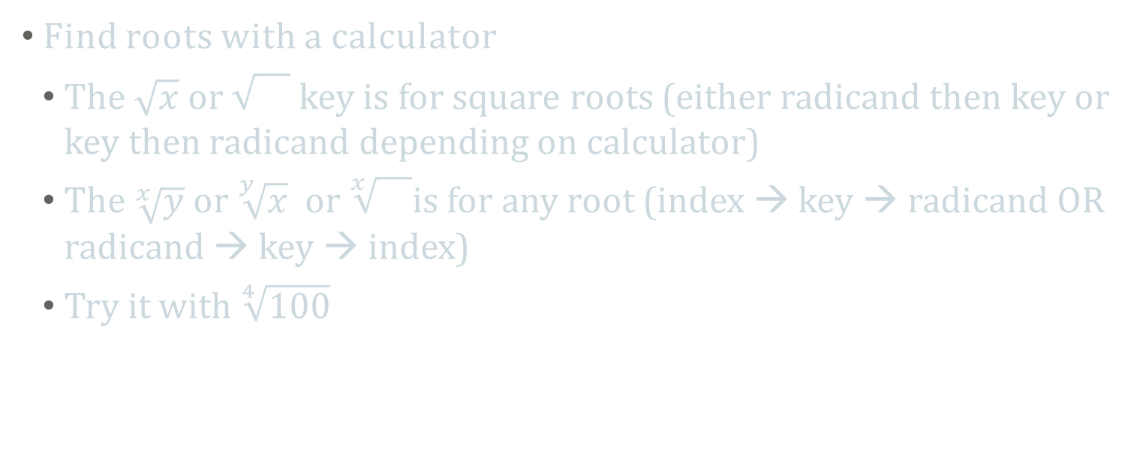
6.1 Evaluate n^{th} Roots and Use Rational Exponents
Find roots with a calculator
  The $\sqrt{x}$ or key is for square roots (either radicand then key or key then radicand depending on calculator)
  The $\sqrt[x]{y}$ or $\sqrt[y]{x}$ or $\sqrt[x]{}$is for any root (index → key → radicand OR radicand → key → index)
  Try it with $\sqrt[4]{100}$
Notes:
3.16

Slide 9
Quiz
6.1 Homework Quiz

Slide 10

6.2 Apply Properties of Rational Exponents
Using Properties of Rational Exponents
  $x^{m}⋅x^{n}=x^{m+n}$
  ${\left(xy\right)}^{m}=x^{m}y^{m}$
  ${\left(x^{m}\right)}^{n}=x^{mn}$
  $\frac{x^{m}}{x^{n}}=x^{m−n}$
  ${\left(\frac{x}{y}\right)}^{m}=\frac{x^{m}}{y^{m}}$
  $x^{−m}=\frac{1}{x^{m}}$

Slide 11
6.2 Apply Properties of Rational Exponents
6^{1/2} ⋅ 6^{1/3}
  (27^{1/3}⋅6^{1/4})²
Notes:
6^{1/2 + 1/3} → 6^{3/6 + 2/6} → 6^{5/6}
(27^{1/3})² ⋅ (6^{1/4})² → 27^{2/3}⋅6^{1/2} → 9⋅6^{1/2}

Slide 12
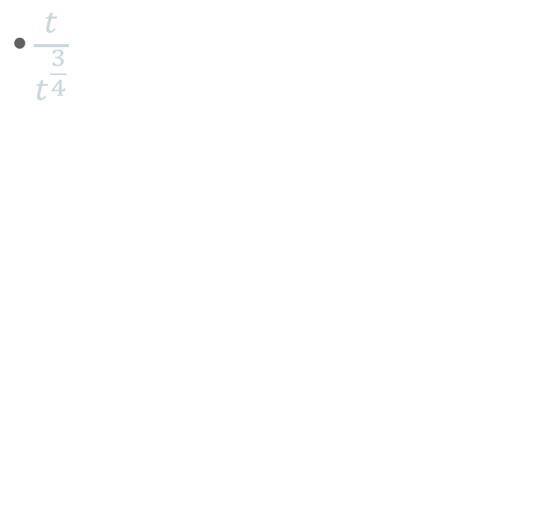
6.2 Apply Properties of Rational Exponents
  (4³⋅w³)^{-1/3}
$\frac{t}{t^{\frac{3}{4}}}$
Notes:
→ 4^{3⋅-1/3}⋅w^{3⋅-1/3} → 4⁻¹⋅w⁻¹ → ¼ ⋅ 1/w → 1/(4w)
→ t^{1-3/4} → t^{1/4}

Slide 13
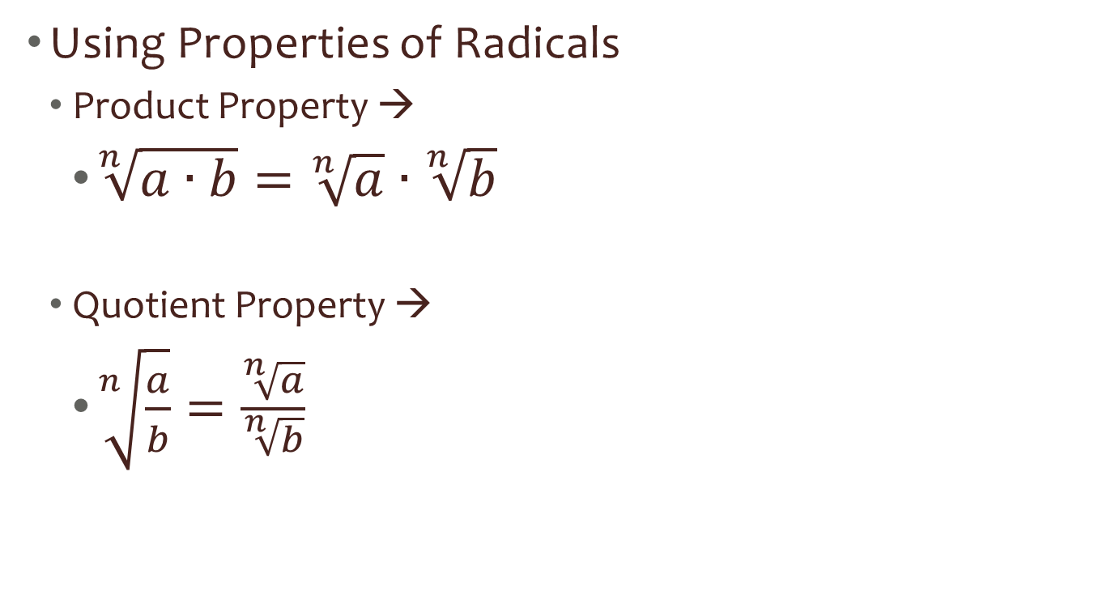
6.2 Apply Properties of Rational Exponents
Using Properties of Radicals
  Product Property →
    $\sqrt[n]{a∙b}=\sqrt[n]{a}∙\sqrt[n]{b}$
  Quotient Property →
    $\sqrt[n]{\frac{a}{b}}=\frac{\sqrt[n]{a}}{\sqrt[n]{b}}$

Slide 14
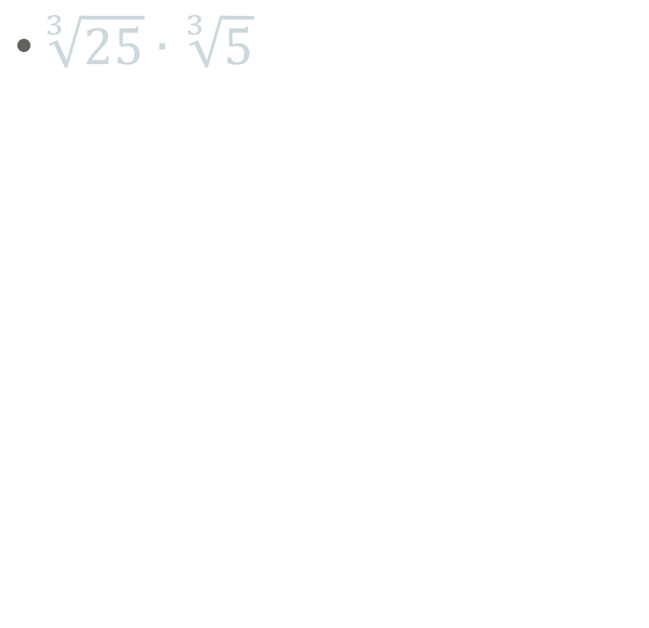
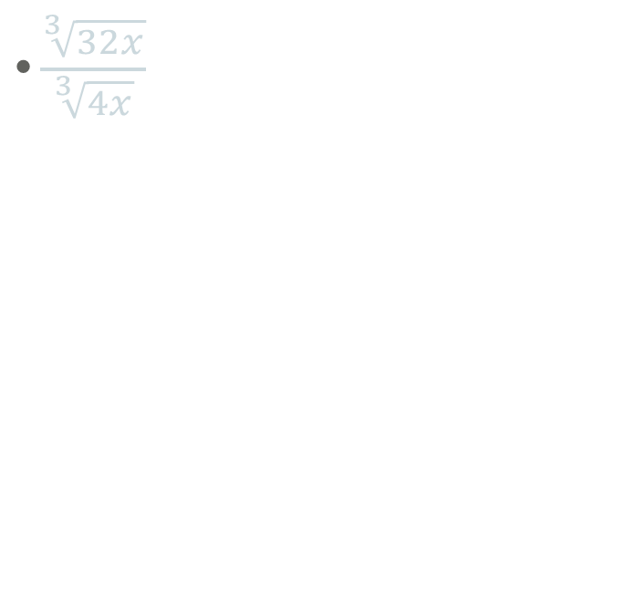
6.2 Apply Properties of Rational Exponents
$\sqrt[3]{25}∙\sqrt[3]{5}$
$\frac{\sqrt[3]{32x}}{\sqrt[3]{4x}}$
Notes:
³√25*5 = ³√125 = 5
³√32x/4x = ³√8 = 2

Slide 15
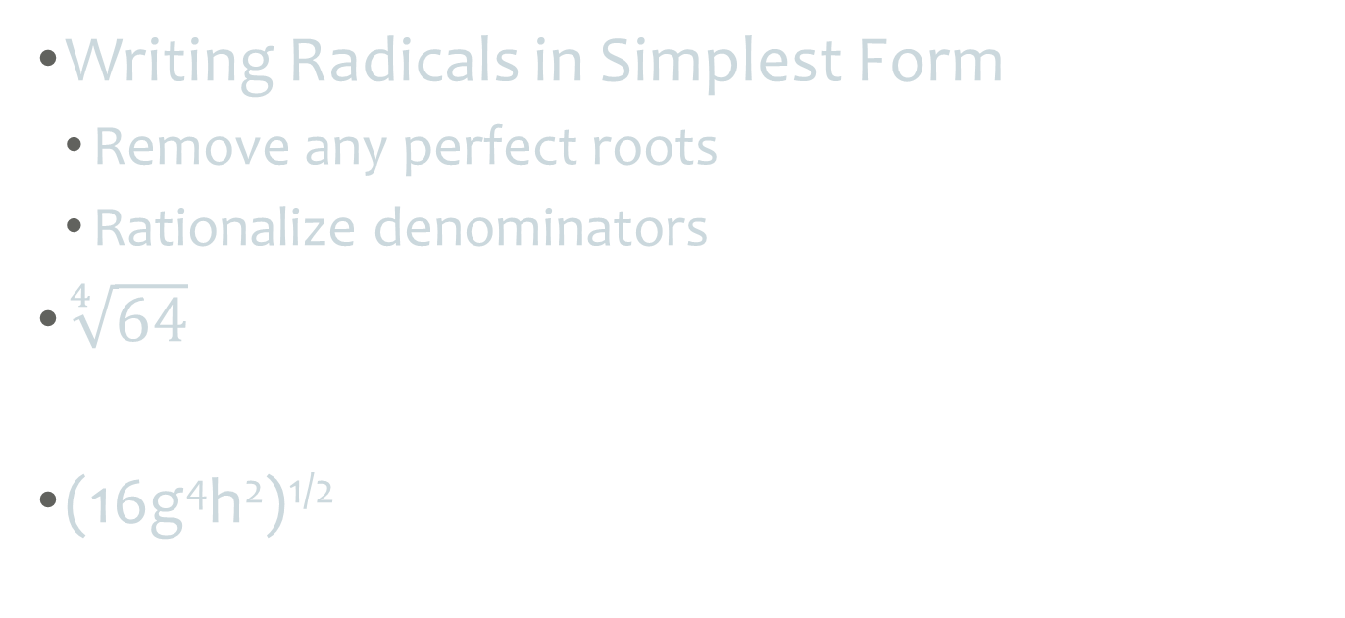
6.2 Apply Properties of Rational Exponents
Writing Radicals in Simplest Form
  Remove any perfect roots
  Rationalize denominators
$\sqrt[4]{64}$
$\text{(16}\text{g}\text{4}\text{h}\text{2}\text{)}\text{1/2}$
Notes:
⁴√2*2*2*2*2*2 = ⁴√(2*2*2*2)*2*2 = 2⁴√4

Slide 16
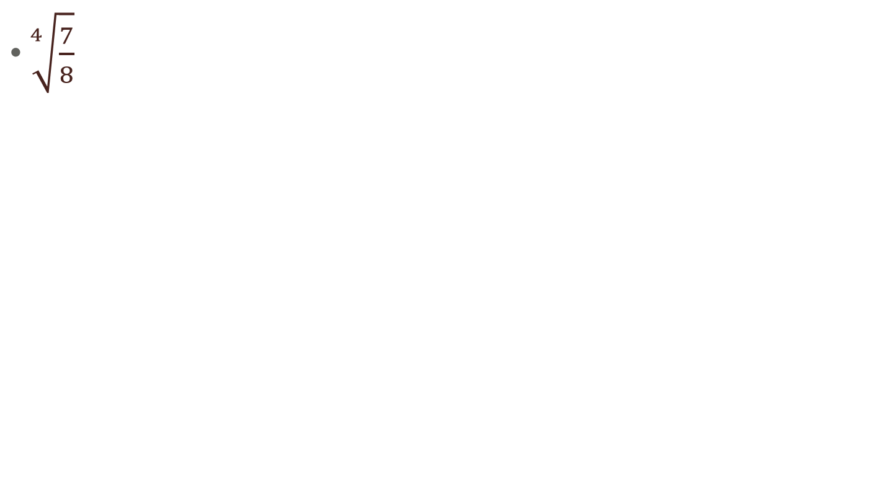
6.2 Apply Properties of Rational Exponents
$\sqrt[4]{\frac{7}{8}}$
Notes:
⁴√7/⁴√8 = 7^{1/4}/8^{1/4} = 7^{1/4}*8^{3/4}/8^{1/4}*8^{3/4} = ⁴√(7*8³)/8 = ⁴√((2*2*2*2)*(2*2*2*2)*2*7)/8 = 2*2*⁴√(2*7)/8 = ⁴√14/2

Slide 17

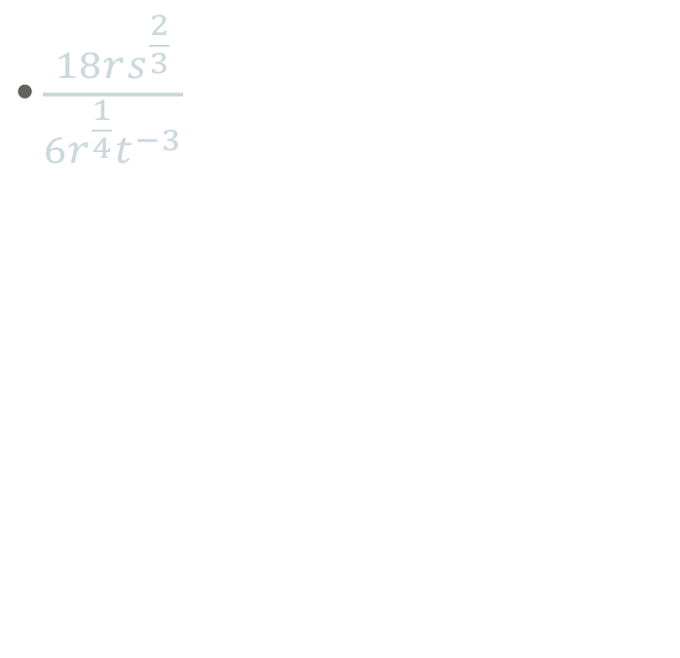
6.2 Apply Properties of Rational Exponents
$\sqrt[5]{\frac{x^{5}}{y^{8}}}$
$\frac{18rs^{\frac{2}{3}}}{6r^{\frac{1}{4}}t^{−3}}$
Notes:
3r^{1-1/4}s^{2/3}t^{0—3} = 3r^{3/4}s^{2/3}t³

Slide 18
6.2 Apply Properties of Rational Exponents
Adding and Subtracting Roots and Radicals
  Simplify the radicals
  Combine like terms
5(4^{3/4}) - 3(4^{3/4})
Notes:
2(4^{3/4})

Slide 19

6.2 Apply Properties of Rational Exponents
$\sqrt[3]{81}−\sqrt[3]{3}$
$2\sqrt[4]{6x^{5}}+x\sqrt[4]{6x}$
Notes:
³√3*3*3*3 - ³√3 = 3 ³√3 - ³√3 = 2 ³√3

Slide 20
Quiz
6.2 Homework Quiz

Slide 21
6.3 Perform Function Operations and Composition
Sometimes for your problems you need to repeat several calculations over and over again (think science class).
It would be quicker to combine all the equations that you are using into one equation first, so that you only have to do one equation each time instead of many.

Slide 22
6.3 Perform Function Operations and Composition
Ways to combine functions
Addition: (f + g)(x) = f(x) + g(x)
Subtraction: (f – g)(x) = f(x) – g(x)
Multiplication: (f ⋅ g)(x) = f(x) ⋅ g(x)
Division: (f/g)(x) = f(x) / g(x)

Slide 23
6.3 Perform Function Operations and Composition
Given f(x) = 2x^{1/2} – 1 and g(x) = x^{1/2} find
  (f + g)(x)
  (f - g)(x)
  (f ⋅ g)(x)
  (f / g)(x)
Notes:
3x^{1/2} –1 D: x ≥ 0
x^{1/2} – 1 D: x ≥ 0
2x – x^{1/2} D: x ≥ 0
(2x^{1/2} – 1)/x^{1/2} D: x > 0

Slide 24
6.3 Perform Function Operations and Composition
Composition
  Put one function into the other. (Like substitution)
  Written f(g(x))
  Said “f of g of x”
  Means that the output (range) of g is the input (domain) of f. Work from the inside out. Do g(x) first then f(x).
  g(x) gets substituted into f(x)

Slide 25
6.3 Perform Function Operations and Composition
Find f(g(x)) when f(x) = 2x + 3 and g(x) = x²
Find g(g(x))
Notes:
Where the x is in f put the g function f(g(x)) = 2(x²) + 3
Simplify f(g(x)) = 2x² + 3
Example: Find g(f(x))
g(f(x)) = g(2x + 3) = (2x + 3)² = 4x² + 12x + 9

Slide 26
Quiz
6.3 Homework Quiz

Slide 27
6.4 Use Inverse Functions
Sometimes you want to do the opposite operation that a given function or equation gives you.
To do the opposite, or undo, the operation you need the inverse function.

Slide 28
6.4 Use Inverse Functions
Properties of Inverses
  x and y values are switched
  graph is reflected over the line y = x
  You can use the Horizontal Line test to determine if the inverse of a function is also a function.
    If a horizontal line can touch a graph more than once, then the inverse is not a function.

Slide 29
6.4 Use Inverse Functions
Definition of inverses
  Two functions are inverses if and only if
    f(g(x)) = x and g(f(x)) = x
  Remember a function is when one x value only goes to one y value (lines are functions, quadratics are functions, square roots are not functions)

Slide 30

6.4 Use Inverse Functions
Verify that f(x) = 6 – 2x and g(x) = $\frac{6−x}{2}$ are inverses.
Notes:
ANS: [f ° g](x) = 6 – 2((6 - x)/2) = 6 – 2(3 – x/2) = 6 – 6 + x = x
[g ° f](x) = (6 – (6 – 2x))/2 = (6 – 6 + 2x)/2 = 2x/2 = x
yes they are inverses

Slide 31

6.4 Use Inverse Functions
Finding inverses
  Inverses switch the x and y coordinates
  Switch x and y and solve for y.
$y=2x+7$
Notes:
$$y=2x+7$$
$$x=2y+7$$
$$x−7=2y$$
$$\frac{x−7}{2}=y$$

Slide 32
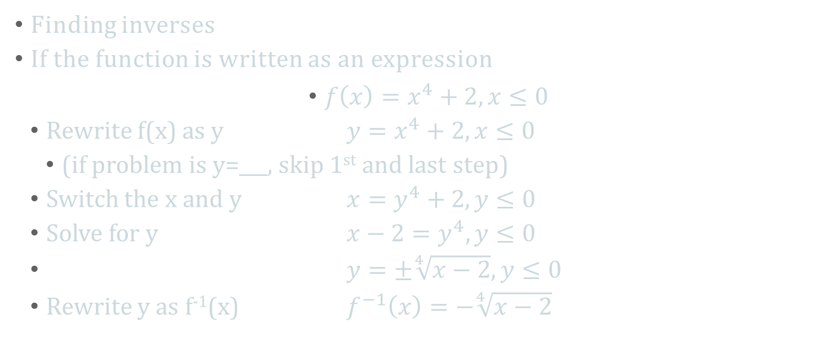
6.4 Use Inverse Functions
Finding inverses
If the function is written as an expression
  $f\left(x\right)=x^{4}+2, x≤0$
  Rewrite f(x) as y $y=x^{4}+2, x≤0$
    (if problem is y=___, skip 1st and last step)
  Switch the x and y $x=y^{4}+2, y≤0$
  Solve for y $x−2=y^{4}, y≤0$
  $y=±\sqrt[4]{x−2}, y≤0$
  Rewrite y as f⁻¹(x) $f^{−1}\left(x\right)=−\sqrt[4]{x−2}$

Slide 33
Quiz
6.4 Homework Quiz

Slide 34
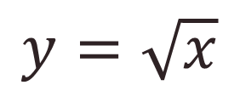
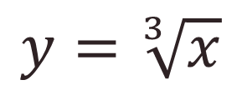
6.5 Graph Square Root and Cube Root Functions
$$y=\sqrt{x}$$
$$y=\sqrt[3]{x}$$
domain x≥0
range y≥0
Domain: all real numbers
Range: all real numbers
Notes:
√x → domain x≥0; range y≥0
³√x → domain x all real numbers; range y all real numbers

Slide 35
Notes:
Show graphs of
y=√x
y=2√x
y=3√x
y=1/2√x
y=-2√x
y=-√x

Slide 36
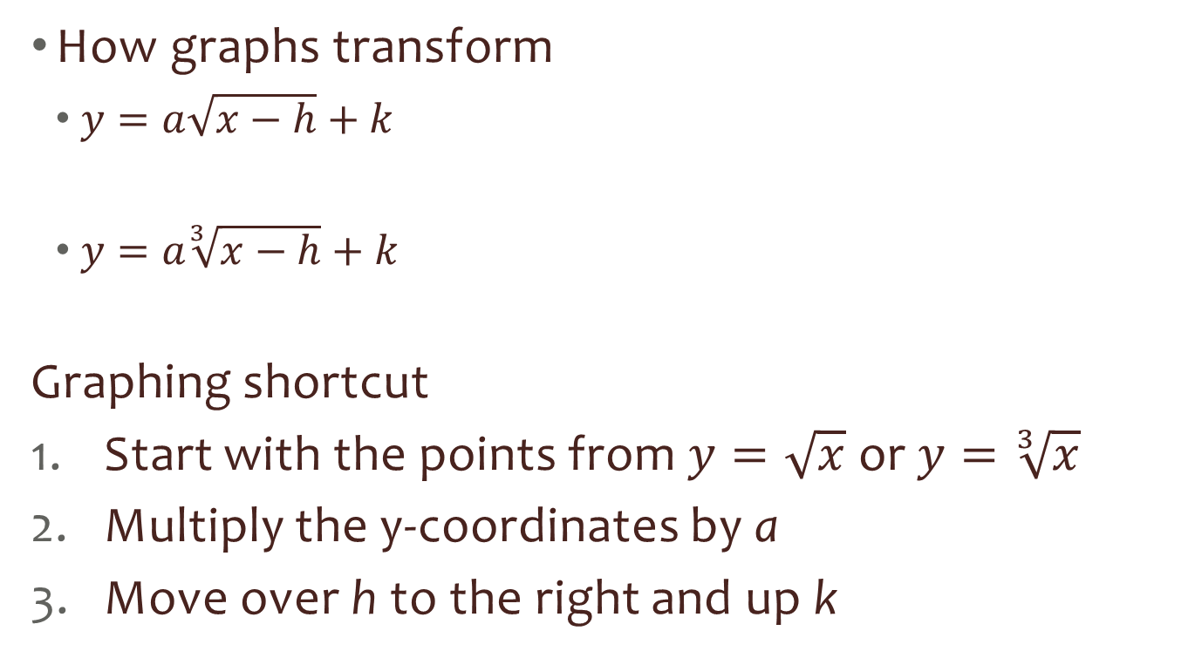
6.5 Graph Square Root and Cube Root Functions
How graphs transform
  $y=a\sqrt{x−h}+k$
  $y=a\sqrt[3]{x−h}+k$
Graphing shortcut
Start with the points from $y=\sqrt{x}$ or $y=\sqrt[3]{x}$
Multiply the y-coordinates by a
Move over h to the right and up k

Slide 37
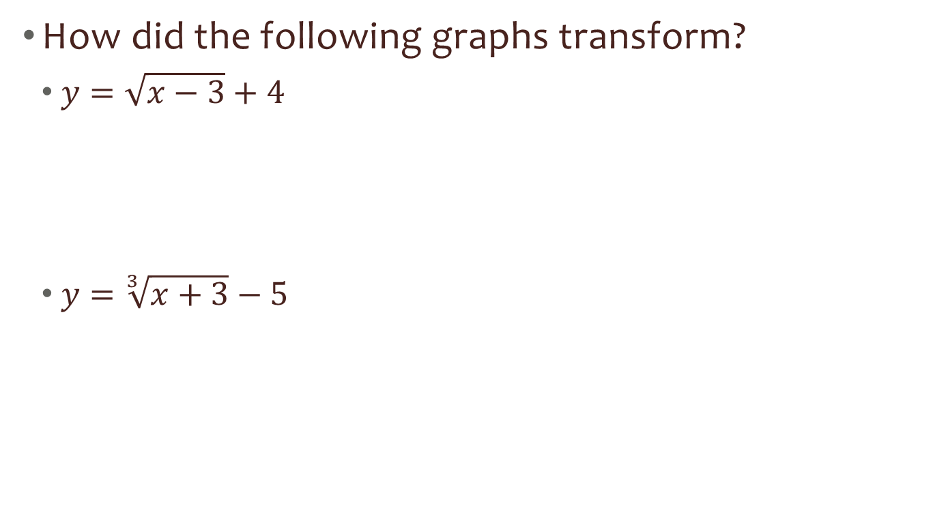
6.5 Graph Square Root and Cube Root Functions
How did the following graphs transform?
  $y=\sqrt{x−3}+4$
  $y=\sqrt[3]{x+3}−5$
Notes:
3 right and 4 up
3 left and 5 down

Slide 38
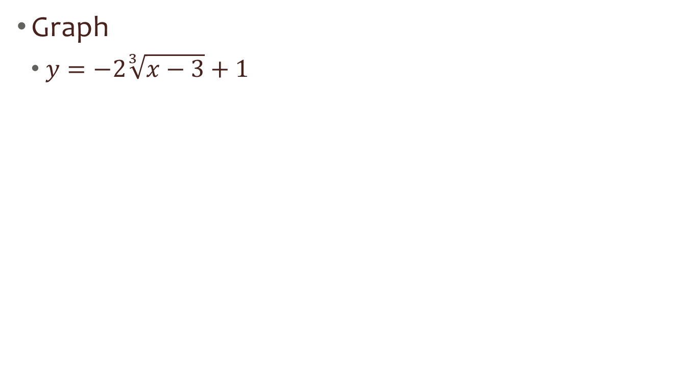
6.5 Graph Square Root and Cube Root Functions
Graph
  $y=−2\sqrt[3]{x−3}+1$

Slide 39

6.5 Graph Square Root and Cube Root Functions
Find the domain and range
  $y=2\sqrt{x+4}−1$
  $y=3\sqrt[3]{x−5}+6$
Notes:
Moved 4 left and 1 down so → Domain: x ≥ 4; Range: y ≥ -1
Cube roots always have Domain: all real numbers and Range: all real numbers

Slide 40
Quiz
6.5 Homework Quiz

Slide 41
6.6 Solve Radical Equations
Radical Equation
  Equation containing a radical
Steps
Isolate the radical
Raise both sides to whatever the index is (or the reciprocal of the exponent)
Solve
Check your answers!!!

Slide 42
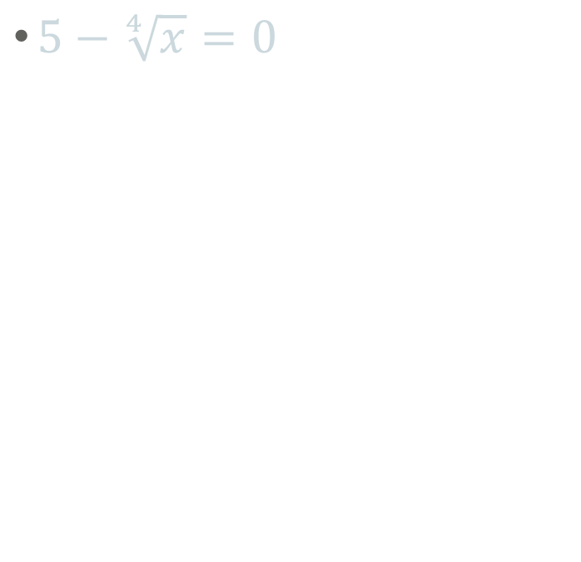
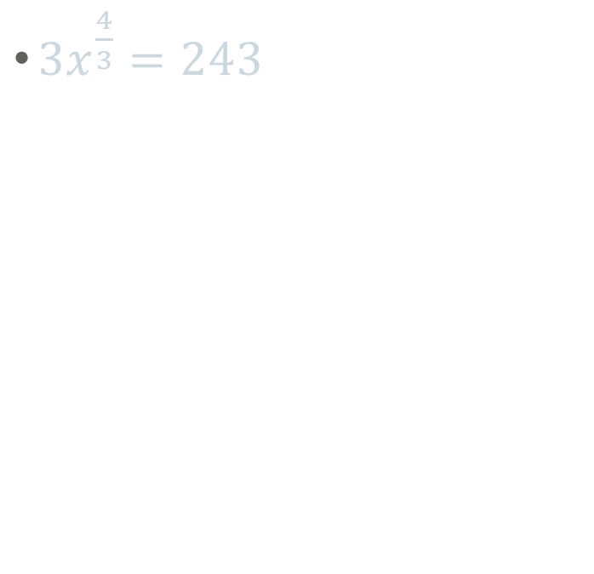
6.6 Solve Radical Equations
$5−\sqrt[4]{x}=0$
$3x^{\frac{4}{3}}=243$
Notes:
5=⁴√x → 5⁴ = x → x = 625
x^{4/3} = 81 → x = +-81^{3/4} = +-27

Slide 43
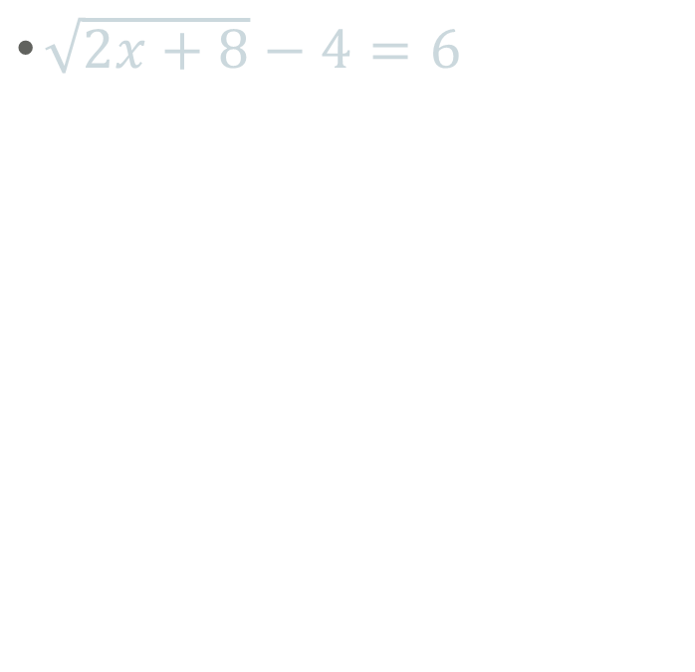
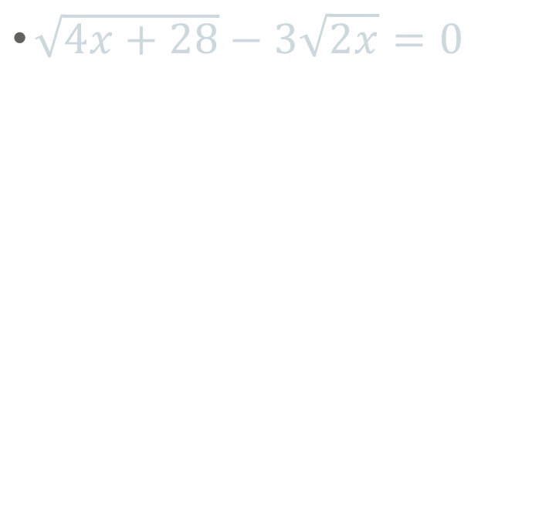
6.6 Solve Radical Equations
$\sqrt{2x+8}−4=6$
$\sqrt{4x+28}−3\sqrt{2x}=0$
Notes:
√(2x+8) = 10 → 2x+8 = 100 → 2x = 92 → x = 46
√(4x+28) = 3√(2x) → 4x+28 = 9(2x) → 4x+28 = 18x → 28 = 14x → x = 2

Slide 44

6.6 Solve Radical Equations
$x+2=\sqrt{2x+28}$
Check!
Notes:
(x+2)² = 2x+28 → x²+4x+4 = 2x+28 → x² +2x -24 = 0 → (x+6)(x-4) = 0 → x = -6, 4
Check
-6: -6+2 = √(2(-6)+28) → -4=√(-12+28) → -4 = 4 False
4: 4+2 = √(2(4)+28) → 6 = √36 → 6=6 True

Slide 45
Quiz
6.6 Homework Quiz

